Slide 1
DISORDERS AND CONDITIONS OF
THE EYE
TITUS K. LEKIRRIE
BscN.
01/12/2020

Slide 2
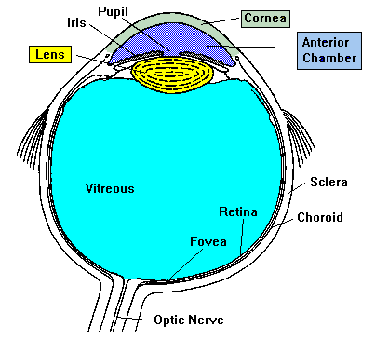
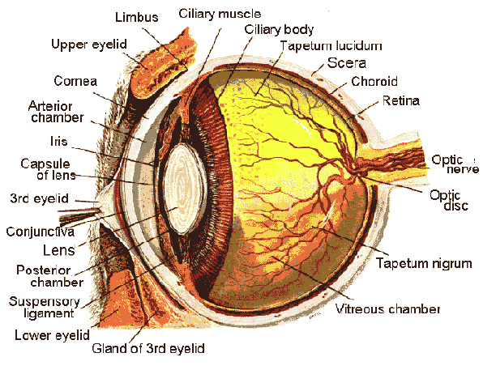
Eyes
  Housed in a cone of fatty tissue
  Eyeball
  Three layers
  External fibrous layer
  Middle vascular layer
  Inner layer of nerve tissue
01/12/2020
Notes:
The mammalian eyeball is an organ that focuses a visual scene onto a sheet of specialized neural tissue, the retina, which lines the back of the eye. Light from a scene passes through the cornea, pupil, and lens on its way to the retina. The cornea and lens focus light from objects onto photoreceptors, which absorb and then convert it into electrical signals that carry information to the brain. Two pockets of transparent fluid nourish eye tissues and maintain constant eye shape: these are the aqueous and vitreous humors, through which the light also passes. The lens projects an inverted image onto the retina in the same way a camera lens projects an inverted image onto film; the brain adjusts this inversion so we see the world in its correct orientation. To control the images that fall upon our retinas, we can either turn our heads or turn our eyes independently of our heads by contracting the extraocular muscles, six bands of muscles that attach to the tough outside covering, or sclera, of the eyeball and are innervated by cranial nerves. See Table 1 for a brief list of eyeball components and their functions.
The cornea and lens bend or refract light rays as they enter the eye, in order to focus images on the retina. The eye can change the extent to which rays are bent and thus can focus images of objects that are various distances from the observer, by varying the curvature of the lens. The ciliary muscle accomplishes this by contracting to lessen tension on the lens and allowing it to round up so it can bend light rays more, or relaxing for the opposite effect. This ciliary muscle is smooth or non-voluntary muscle-you cannot "decide" to contract or relax it as you do the skeletal muscle in a finger or facial muscle.
3. Refractive errors in the eye cause focusing problems
Refractive errors occur when the bending of light rays by the cornea and lens does not focus the image correctly onto the retina. An eyeball that is too long or too short for the optics of the cornea and lens or an irregularly shaped cornea can cause refractive errors, which include myopia (near-sightedness), hyperopia (far-sightedness), and astigmatism. Myopia results either when the eyeball is too short or when the cornea is curved too much, and the focused image falls in front of the retina. Hyperopia is the opposite, with the image falling behind the retina. Astigmatism results from a cornea that is not spherical. Fortunately, most refractive errors can be corrected with prescription lenses.
Aqueous humor clear watery fluid found in the anterior chamber of the eye; maintains pressure and nourishes the cornea and lens
Vitreous humor clear, jelly-like fluid found in the back portion of the eye: maintains shape of the eye and attaches to the retina
Blind spot small area of the retina where the optic nerve leaves the eye: any image falling here will not be seen
Ciliary muscles involuntary muscles that change the lens shape to allow focusing images of objects at different distances
Cornea transparent tissue covering the front of the eye: does not have blood vessels; does have nerves
Cones photoreceptors responsive to color and in bright conditions; used for fine detail
Rods photoreceptors responsive in low light conditions; not useful for fine detail
Fovea central part of the macula that provides sharpest vision; contains only cones
Iris circular band of muscles that controls the size of the pupil. The pigmentation of the iris gives "color" to the eye. Blue eyes have the least amount of pigment; brown eyes have the most
Lens transparent tissue that bends light passing through the eye: to focus light, the lens can change shape
Macula small central area of the retina that provides vision for fine work and reading
Optic nerve bundle of over one million axons from ganglion cells that carry visual signals from the eye to the brain
Pupil hole in the center of the eye where light passes through
Choroid Thin tissue layer containing blood vessels, sandwiched between the sclera and retina; also, because of the high melanocytes content, the choroid acts as a light-absorbing layer.
Retina layer of tissue on the back portion of the eye that contains cells responsive to light (photoreceptors)
Sclera tough, white outer covering of the eyeball; extraocular muscles attach here to move the eye

Slide 3
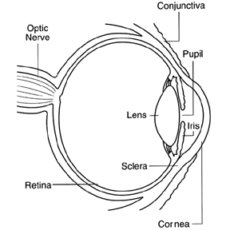
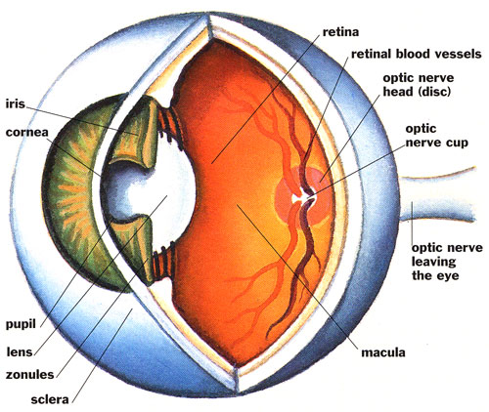
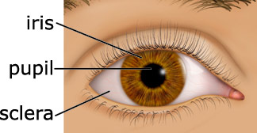
Anatomy of the Eye
11/1/2011

Slide 4
External Fibrous Layer
Sclera
  “white of eye’
    Protective & supportive outer layer
Cornea
  Dense fibrous connective tissue
    Must be transparent to allow light
01/12/2020
Notes:
Our visual systems perform all kinds of amazing jobs, from finding constellations in the night sky, to picking out just the right strawberry in the supermarket, to tracking a fly ball into a waiting glove. How do our eyes and brains recognize shape, movement, depth, and color? How do we so easily pick a friend's face out of a crowd, yet get fooled by optical illusions? In this first of three units on the Sense of Sight, we consider the anatomy and physiology of the eye, especially the retina, and the initial pathways visual information takes to the brain. Part 2 discusses how various aspects of a visual scene are processed at higher levels, and Part 3 delves into color vision. 1. Our eyes allow us to perceive electromagnetic radiation reflected from objects
Most animals and many plants are photosensitive; that is, they can detect different light intensities. Some organisms accomplish this with single cells or with simple eyes that do not form images but do allow the organism to react to light by moving toward or away from it. In order for an eye to transmit more information about the world, however, it must have a way of forming an image, a representation of the scene being viewed.
Higher invertebrates and virtually all vertebrates have complex, image-forming eyes, and we will "focus" on the refracting eye found in the octopus and in all vertebrates. Arthropods have compound eyes, which have greater depth of focus than refracting eyes, but which sacrifice resolving power or acuity. Our eyes, like those of many animals, detect a just narrow range of all the wavelengths of electromagnetic radiation, that between 380 and 760 nanometers. This range of light is called the visible spectrum. Figure 1 shows how the visible spectrum fits into the entire electromagnetic spectrum.

Slide 5
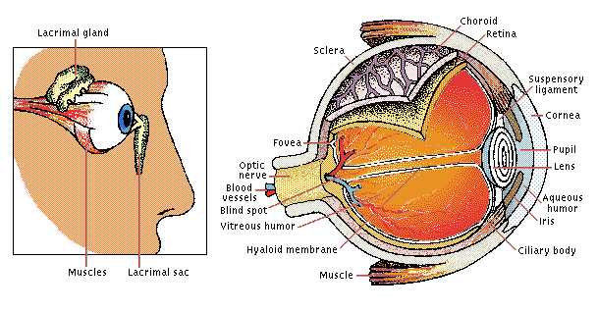
Middle Vascular Layer
Heavily pigmented
Blood vessels
11/1/2011

Slide 6
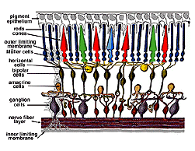
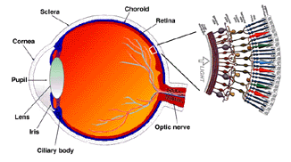
Inner Layer
Retina
  Continuous with optical nerve in rear
  Ora serrata in front
  Two parts
    Outer part-pigmented-attached to choroid layer
    Inner part is nerve tissue
11/1/2011
Notes:
In the center of the retina is the optic nerve, a circular to oval white area measuring about 2 x 1.5 mm across. From the center of the optic nerve radiate the major blood vessels of the retina. Approximately 17 degrees (4.5-5 mm), or two and half disc diameters to the left of the disc, can be seen the slightly oval-shaped, blood vessel-free reddish spot, the fovea, which is at the center of the area known as the macula by ophthalmologists.
A circular field of approximately 6 mm around the fovea is considered the central retina while beyond this is peripheral retina stretching to the ora serrata, 21 mm from the center of the optic disc. The total retina is a circular disc of approximately 42 mm diameter.
The retina is approximately 0.5 mm thick and lines the back of the eye. The optic nerve contains the ganglion cell axons running to the brain and, additionally, incoming blood vessels that open into the retina to vascularize the retinal layers and neurons. A radial section of a portion of the retina reveals that the ganglion cells (the output neurons of the retina) lie innermost in the retina closest to the lens and front of the eye, and the photosensors (the rods and cones) lie outermost in the retina against the pigment epithelium and choroid. Light must, therefore, travel through the thickness of the retina before striking and activating the rods and cones. Subsequently the absorbtion of photons by the visual pigment of the photoreceptors is translated into first a biochemical message and then an electrical message that can stimulate all the succeeding neurons of the retina. The retinal message concerning the photic input and some preliminary organization of the visual image into several forms of sensation are transmitted to the brain from the spiking discharge pattern of the ganglion cells.
When an anatomist takes a vertical section of the retina and processes it for microscopic examination it becomes obvious that the retina is much more complex and contains many more nerve cell types than the simplistic scheme had indicated. It is immediately obvious that there are many interneurons packed into the central part of the section of retina intervening between the photoreceptors and the ganglion cells.
All vertebrate retinas are composed of three layers of nerve cell bodies and two layers of synapses. The outer nuclear layer contains cell bodies of the rods and cones, the inner nuclear layer contains cell bodies of the bipolar, horizontal and amacrine cells and the ganglion cell layer contains cell bodies of ganglion cells and displaced amacrine cells. Dividing these nerve cell layers are two neuropils where synaptic contacts occur.
The first area of neuropil is the outer plexiform layer (OPL) where connections between rod and cones, and vertically running bipolar cells and horizontally oriented horizontal cells occur.
The second neuropil of the retina, is the inner plexiform layer (IPL), and it functions as a relay station for the vertical-information-carrying nerve cells, the bipolar cells, to connect to ganglion cells. In addition, different varieties of horizontally- and vertically-directed amacrine cells, somehow interact in further networks to influence and integrate the ganglion cell signals. It is at the culmination of all this neural processing in the inner plexiform layer that the message concerning the visual image is transmitted to the brain along the optic nerve.
Central and peripheral retina compared.
Central retina close to the fovea is considerably thicker than peripheral retina (see sections of retina below). This is due to the increased packing density of photoreceptors, particularly the cones, and their associated bipolar and ganglion cells in central retina compared with peripheral retina.
Central retina is cone-dominated retina whereas peripheral retina is rod-dominated. Thus in central retina the cones are closely spaced and the rods fewer in number between the cones.
The outer nuclear layer (ONL), composed of the cell bodies of the rods and cones is about the same thickness in central and peripheral retina. However in the peripheral the rod cell bodies outnumber the cone cell bodies while the reverse is true for central retina. In central retina, the cones have oblique axons displacing their cell bodies from their synaptic pedicles in the outer plexiform layer (OPL). These oblique axons with accompanying Muller cell processes form a pale-staining fibrous-looking area known as the Henle fibre layer. The latter layer is absent in peripheral retina.
The inner nuclear layer (INL) is thicker in the central area of the retina compared with peripheral retina, due to a greater density of cone-connecting second-order neurons (cone bipolar cells) and smaller-field and more closely-spaced horizontal cells and amacrine cells concerned with the cone pathways. As we shall see later, cone-connected circuits of neurons are less convergent in that fewer cones impinge on second order neurons, than rods do in rod-connected pathways.
A remarkable difference between central and peripheral retina can be seen in the relative thicknesses of the inner plexiform layers (IPL), ganglion cell layers (GCL) and nerve fibre layer (NFL). This is again due to the greater numbers and increased packing-density of ganglion cells needed for the cone pathways in the cone-dominant foveal retina as compared the rod-dominant peripheral retina. The greater number of ganglion cells means more synaptic interaction in a thicker IPL and greater numbers of ganglion cell axons coursing to the optic nerve in the nerve fibre layer.
3. Muller glial cells.
Muller cells are the radial glial cells of the retina. The outer limiting membrane (OLM) of the retina is formed from adherens junctions between Muller cells and photoreceptor cell inner segments. The inner limiting membrane (ILM) of the retina is likewise composed of laterally contacting Muller cell end feet and associated basement membrane constituents.
The OLM forms a barrier between the subretinal space, into which the inner and outer segments of the photoreceptors project to be in close association with the pigment epithelial layer behind the retina, and the neural retina proper. The ILM is the inner surface of the retina bordering the vitreous humor and thereby forming a diffusion barrier between neural retina and vitreous humor.
Throughout the retina the major blood vessels of the retinal vasculature supply the capillaries that run into the neural tissue. Capillaries are found running through all parts of the retina from the nerve fibre layer to the outer plexiform layer and even occasionally as high as in the outer nuclear layer. Nutrients from the vasculature of the choriocapillaris (cc) behind the pigment epithelium layer supply the delicate photoreceptor layer.
4. Foveal structure.
The center of the fovea is known as the foveal pit and is a highly specialized region of the retina different again from central and peripheral retina we have considered so far. Radial sections of this small circular region of retina measuring less than a quarter of a millimeter (200 microns) across is shown below for human and for monkey.
The foveal pit is an area where cone photoreceptors are concentrated at maximum density with exclusion of the rods, and arranged at their most efficient packing density which is in a hexagonal mosaic. This is more clearly seen in a tangential section through the foveal cone inner segments.
Below this central 200 micron diameter central foveal pit, the other layers of the retina are displaced concentrically leaving only the thinnest sheet of retina consisting of the cone cells and some of their cell bodies. Radially distorted but complete layering of the retina then appears gradually along the foveal slope until the rim of the fovea is made up of the displaced second- and third-order neurons related to the central cones. Here the ganglion cells are piled into six layers so making this area, called the foveal rim or parafovea (Polyak, 1941), the thickest portion of the entire retina.
5. Macula lutea.
The whole foveal area including foveal pit, foveal slope, parafovea and perifovea is considered the macula of the human eye. Familiar to ophthalmologists is a yellow pigmentation to the macular area known as the macula lutea.
This pigmentation is the reflection from yellow screening pigments, the xanthophyll carotenoids zeaxanthin and lutein (Balashov and Bernstein, 1998), present in the cone axons of the Henle fibre layer. The macula lutea is thought to act as a short wavelength filter, additional to that provided by the lens. As the fovea is the most essential part of the retina for human vision, protective mechanisms for avoiding bright light and especially ultraviolet irradiation damage are essential. For, if the delicate cones of our fovea are destroyed we become blind.
The yellow pigment that forms the macula lutea in the fovea can be clearly demonstrated by viewing a section of the fovea in the microscope with blue light. The dark pattern in the foveal pit extending out to the edge of the foveal slope is caused by the macular pigment distribution.
If one were to visualize the foveal photoreceptor mosaic as though the visual pigments in the individual cones were not bleached. The short-wavelength sensitive cones on the foveal slope look pale yellow green, the middle wavelength cones, pink and the long wavelength sensitive cones, purple. If we now add the effect of the yellow screening pigment of the macula lutea we see the appearance of the cone mosaic in Figure 16 An effect akin to the mosaic "wearing sunglasses": the protective value of the xanthophyll screening pigment can be appreciated.
6. Blood supply to the retina.
There are two sources of blood supply to the mammalian retina: the central retinal artery and the choroidal blood vessels. The choroid receives the greatest blood flow (65-85%)) and is vital for the maintainance of the outer retina (particularly the photoreceptors) and the remaining 20-30% flows to the retina through the central retinal artery from the optic nerve head to nourish the inner retinal layers. The central retinal artery has 4 main branches in the human retina.
The arterial intraretinal branches then supply three layers of capillary networks i.e. 1) the radial peripapillary capillaries (RPCs) and 2) an inner and 3) an outer layer of capillaries. The precapillary venules drain into venules and through the corresponding venous system to the central retinal vein
The radial peripapillary capillaries (RPCs) are the most superfical layer of capillaries lying in the inner part of the nerve fiber layer, and run along the paths of the major superotemporal and inferotemporal vessels 4-5 mm from the optic disk. The RPCs anatomose with each other and the deeper capillaries. The inner capillaries lie in the ganglion cell layers under and parallel to the RPCs. The outer capillary network runs from the inner plexiform layer to the outer plexiform layer thought the inner nuclear layer.
As will be noticed from the flourescein angiography, there as a ring of blood vessels in the macular area around a blood vessel- and capillary-free zone 450-600 _m in diameter, denoting the fovea. The macular vessels arise from branches of the superior temporal and inferotemporal arteries. At the border of the avascular zone the capillaries become two layered and finally join as a single layered ring. The collecting venules are more deep (posterior) to the arterioles and drain blood flow back into the main veins. In the rhesus monkey this perimacular ring and blood vessel free fovea is clearly seen in the beautiful drawings made by Max Snodderly's group.
The choroidal arteries arise from long and short posterior ciliary arteries and branches of Zinn's circle (around the optic disc). Each of the posterior ciliary arteries break up into fan-shaped lobules of capillaries that supply localized regions of the choroid. The macular area of the choroidal vessels are not specialized like the retinal blood supply is . The arteries pierce the sclera around the optic nerve and fan out to form the three vascular layers in the choroid: outer (most scleral), medial and inner (nearest Bruchs membrane of the pigment epithelium) layers of blood vessels. This is clearly shown in the corrosion cast of a cut face of the human choroid. The corresponding venous lobules drain into the venules and veins that run anterior towards the equator of the eyeball to enter the vortex veins. One or two vortex veins drain each of the 4 quadrants of the eyeball. The vortex veins penetrate the sclera and merge into the ophthalmic vein.
7. Degenerative diseases of the human retina.
The human retina is a delicate organization of neurons, glia and nourishing blood vessels. In some eye diseases, the retina becomes damaged or compromised, and degenerative changes set in that eventally lead to serious damage to the nerve cells that carry the vital messages about the visual image to the brain. We indicate four different conditions where the retina is diseased and blindness may be the end result.
Age related macular degeneration is a common retinal problem of the aging eye and a leading cause of blindness in the world. The macular area and fovea become compromised due to the pigment epithelium behind the retina degenerating and forming drusen (white spots and allowing leakage of fluid behind the fovea. The cones of the fovea die causing central visual loss so we cannot read or see fine detail.
Glaucoma is also a common problem in aging, where the pressure within the eye becomes elevated. The pressure rises because the anterior chamber of the eye cannot exchange fluid properly by the normal aqueous outflow methods. The pressure within the vitreous chamber rises and compromises the blood vessels of the optic nerve head and eventually the axons of the ganglion cells so that these vital cells die. Treatment to reduce the intraocular pressure is essential in glaucoma.
Retinits pigmentosa is a nasty hereditary disease of the retina for which there is no cure at present. It comes in many forms and consists of large numbers of genetic mutations presently being analysed. Most of the faulty genes that have been discoverd concern the rod photoreceptors. The rods of the peripheral retina begin to degenerate in early stages of the disease. Patients become night blind gradually as more and more of the peripheral retina (where the rods reside) becomes damaged. Eventally patients are reduced to tunnel vision with only the fovea spared the disease process. Characteristic pathology is the occurence of black pigment in the peripheral retina and thinned blood vessels at the optic nerve head.
Diabetic retinopathy is a side effect of diabetes that affects the retina and can cause blindness. The vital nourishing blood vessels of the eye become compromised, distorted and multiply in uncontrollable ways. Laser treatment for stopping blood vessel proliferation and leakage of fluid into the retina, is the commonest treatment at present.

Slide 7

Eyelids
  Tarsal glands secrete oil to lubricate
Lacrimal glands – outer edge of eye socket
  Secretes tears to clean & protect
Aqueous humor – between cornea & lens
  Salty clear fluid
01/12/2020

Slide 8
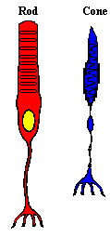
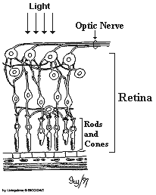
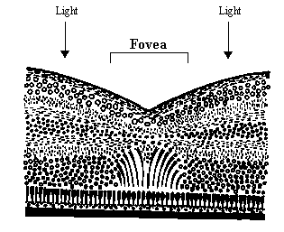

Retina
Thin membrane lining rear of eye
Contains light sensitive cells
Rods & cones
  Rods are sensitive to light
    120 million rods
  Cones are sensitive to colors
    6 million cones
01/12/2020
Notes:
The rods are most sensitive to light and dark changes, shape and movement and contain only one type of light-sensitive pigment. Rods are not good for color vision. In a dim room, however, we use mainly our rods, but we are "color blind." Rods are more numerous than cones in the periphery of the retina. Next time you want to see a dim star at night, try to look at it with your peripheral vision and use your ROD VISION to see the dim star. There are about 120 million rods in the human retina.
The cones are not as sensitive to light as the rods. However, cones are most sensitive to one of three different colors (green, red or blue). Signals from the cones are sent to the brain which then translates these messages into the perception of color. Cones, however, work only in bright light. That's why you cannot see color very well in dark places. So, the cones are used for color vision and are better suited for detecting fine details. There are about 6 million cones in the human retina. Some people cannot tell some colors from others - these people are "color blind." Someone who is color blind does not have a particular type of cone in the retina or one type of cone may be weak. In the general population, about 8% of all males are color blind and about 0.5% of all females are color blind.
The fovea,, is the region of the retina that provides for the most clear vision. In the fovea, there are NO rods...only cones. The cones are also packed closer together here in the fovea than in the rest of the retina. Also, blood vessels and nerve fibers go around the fovea so light has a direct path to the photoreceptors.
One part of the retina does NOT contain any photoreceptors. This is our "blind spot". Therefore any image that falls on this region will NOT be seen. It is in this region that the optic nerves come together and exit the eye on their way to the brain.

Slide 9
EYE EXAMINATION
History taking
Visual loss or discomfort
Poor vision
Medical conditions e.g HTN, DM
Drugs e.g chlorouine,isoniazid
Family Hx. E.g retinitis, glaucoma
Allergies & infections eg conjunctivitis.
11/1/2011

Slide 10
Cont…
Sudden visual loss…optic nerve
Retinal abnormalities i.e total occlusion of central vein
Optic nerve abnormalities i.e demyelination of optic nerve
01/12/2020

Slide 11
Examination
Both structure and function are examined.
Physiologic examination.
Visual Acuity
Visual fields
IntraOccular pressure
01/12/2020

Slide 12
Visual Acuity
Tests visual resolving power of the eye.
Snellen chart
Acuity..reading distance over row number of smallest number seen e.g 6meters
Cardiff Acuity test for 1-3 years.
Sheridan-Gardiner test for older children.

Slide 13
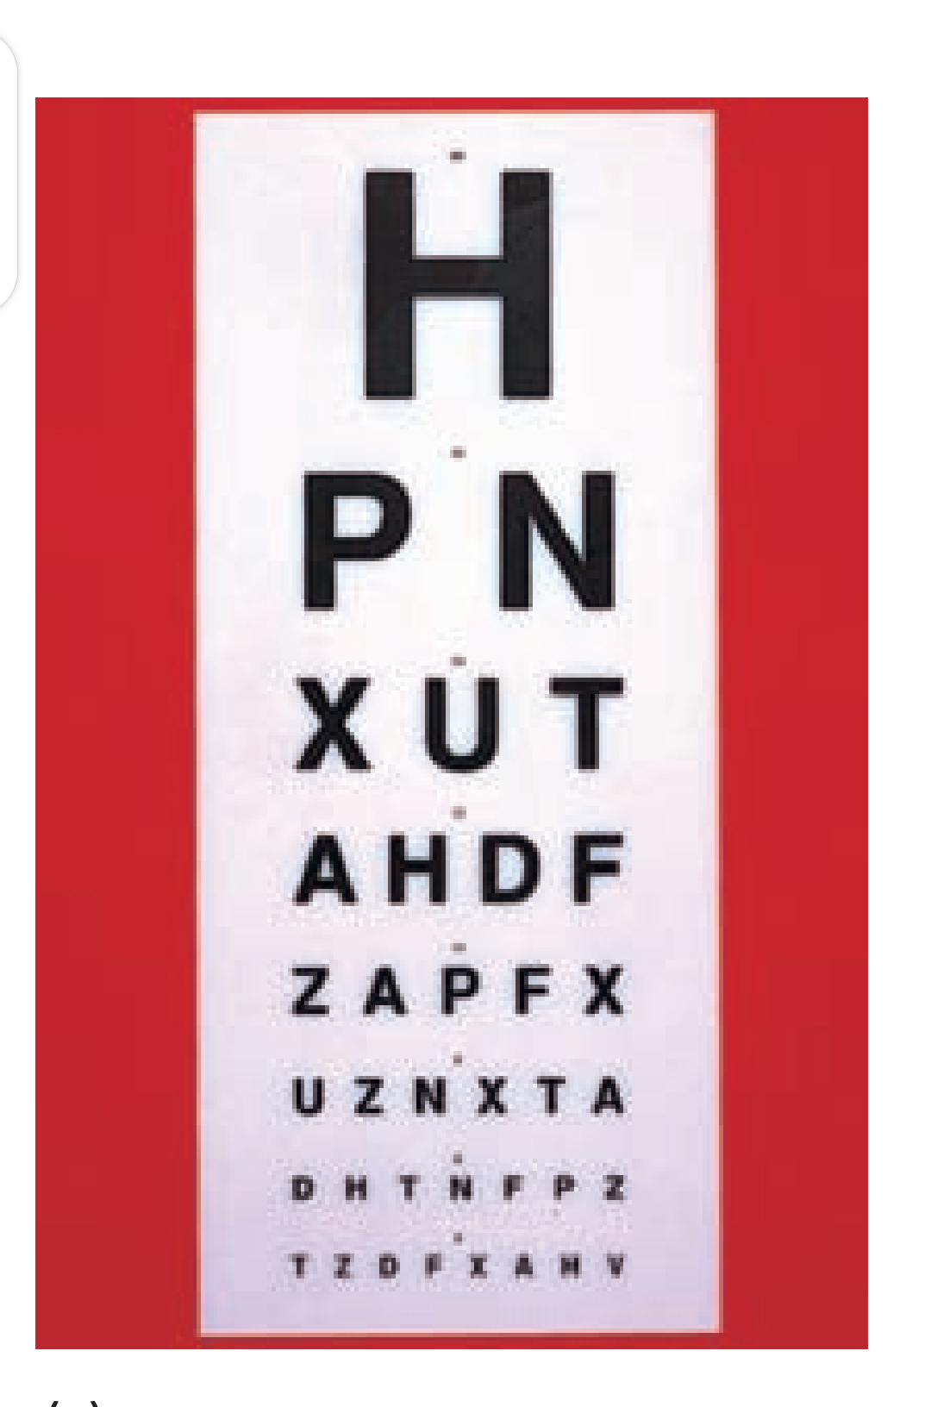
Snellen Chart
01/12/2020

Slide 14
Visual Fields
Maps peripheral extend of the visual world.
Blindspot..no photoreceptors
VF is tested through;
Confrontation tests- comparison of VF of examiner & patient.
Perimeter machine- tests kinetic and static VF.
01/12/2020

Slide 15
Intraoccular Pressure
Measured by contact technique using Goldmann tonometer.
Plastic cylinder pressed against anaesthetized cornea.
Force applied to cylinder varies to alter amount of corneal flattening.
11/1/2011

Slide 16
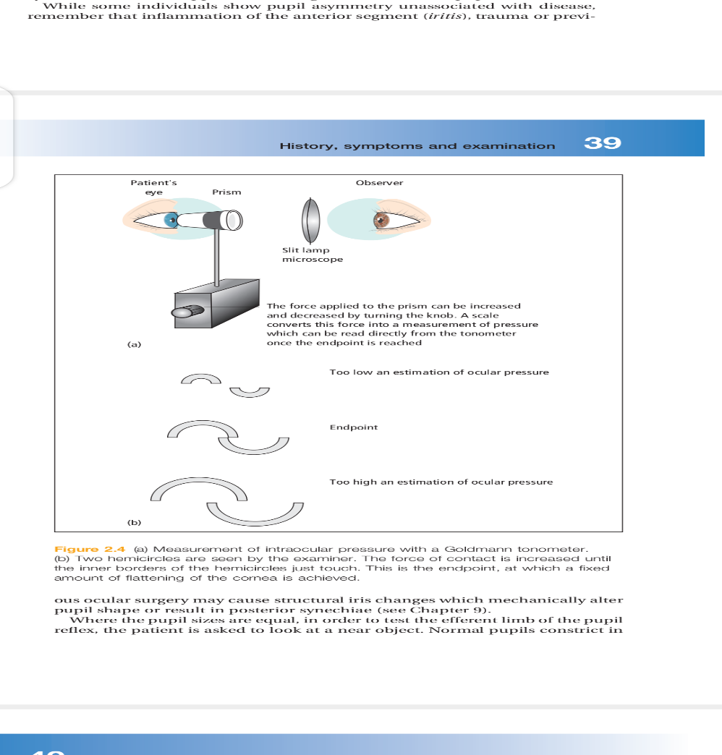
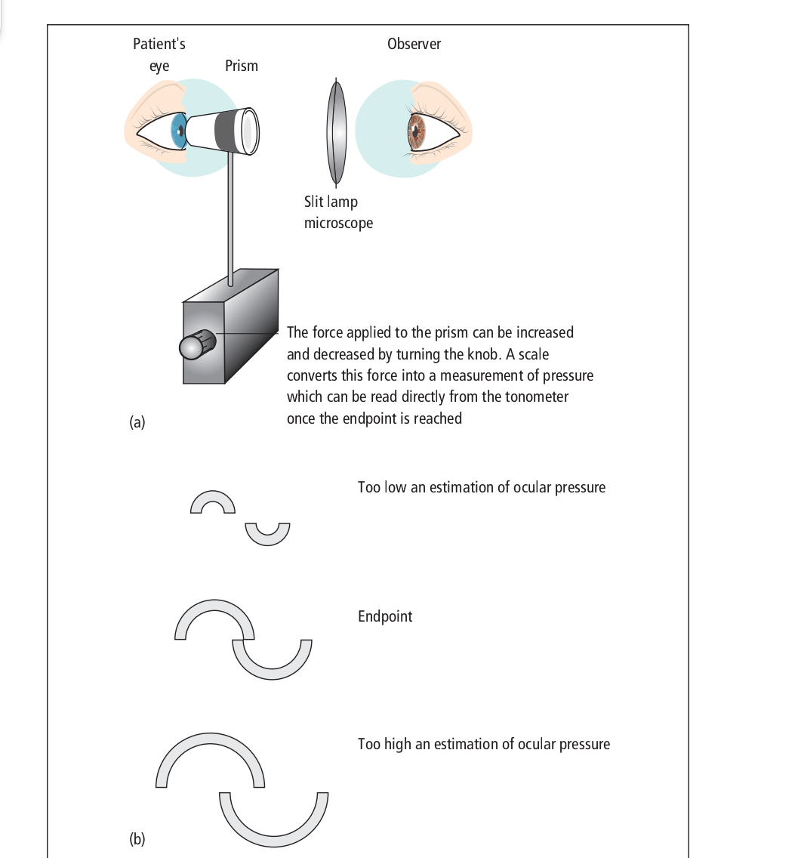
Goldmann Tonometer
01/12/2020

Slide 17
EYE DISORDERS
REFRACTIVE ERRORS
MUSCULAR DISORDERS
DISORDERS OF THE EYELID
DISORDERS OF THE GLOBE OF THE EYE
01/12/2020

Slide 18
REFRACTIVE ERRORS
HYPEROPIA.
MYOPIA.
ASTIGMATISM
PRESBYOPIA
01/12/2020

Slide 19
HYPEROPIA (FAR SIGHTEDNESS)
MECHANISM
  * object focuses behind the retina
  * able to see only far objects
ETIOLOGY
  * genetic link
01/12/2020

Slide 20
SYMPTOMS AND SIGNS
  * blurred vision
  * squinting
  * eye rubbing
  * headaches
DIAGNOSIS
  * Snellen visual acuity test
  * ophthalmoscope
TREATMENT
  * Convex lens
01/12/2020

Slide 21
MYOPIA (NEAR SIGHTEDNESS)
MECHANISM
  * object focuses in front of the retina
  * able to see only close objects
ETIOLOGY
  * genetic link
SYMPTOMS AND SIGNS
  * blurred vision
  * squinting
  * eye rubbing* headaches
11/1/2011

Slide 22
DIAGNOSIS
  * Snellen visual acuity test
  * opthalmoscope
TREATMENT
  * concave lens
  * radical keratotomy - shallow incision in the cornea causing it to flatten in desired area
  (could have significant complications)
01/12/2020

Slide 23
ASTIGMATISM
MECHANISM
  * Abnormal shaped cornea
  (egg shape instead of spherical)
  * object is partially clear & other blurred
ETIOLOGY
  * genetic link
01/12/2020

Slide 24
SYMPTOMS AND SIGNS
  * blurred vision
  * squinting
  * eye rubbing
  * headaches
DIAGNOSIS
  * Snellen visual acuity test
  * opthalmoscope
TREATMENT
  * artificial lens transplan * radial keratotomy
11/1/2011

Slide 25
PRESBYOPIA
MECHANISM
  * Rigidity of the lens (old age)
  * unable to focus
ETIOLOGY
  * genetic link
SYMPTOMS AND SIGNS
  * blurred vision
  * squinting
  * eye rubbing
  * headaches
11/1/2011

Slide 26
DIAGNOSIS
  * Snellen visual acuity test
  * opthalmoscope
TREATMENT
  * lens transplant
01/12/2020

Slide 27
MUSCULAR DISORDERS
NYSTAGMUS
STRABISMUS (CROSS EYED)
01/12/2020

Slide 28
NYSTAGMUS
MECHANISM
* repetitive involuntary movements of one or both eyes
ETIOLOGY
* Congenital
* Brain tumors
* CV lesions
* Ear lesions
* Alcohol/drug abuse
11/1/2011

Slide 29
SYMPTOMS AND SIGNS
  * Eye Movements
  *Horizontal, vertical, circular, or combination
  * blurred vision
DIAGNOSIS
  * viewing of the eyes - involuntary movement
  * complete neurological tests
TREATMENT
  * Treat the underlying condition
  * Congenital stays for life
11/1/2011

Slide 30
STRABISMUS (CROSS EYED)
MECHANISM
  * Failure of eyes to look in the same direction at the same time
  * Weakness of muscles of one eye
  (superior oblique, interior oblique, lateral)
ETIOLOGY
  in childhood: associated with amblyopia (decreased vision in one eye)
  (reversible after 7 years of age)
  in adults: Usually caused by disease:
  i.e. diabetes, high blood pressure, brain trauma
11/1/2011

Slide 31
SYMPTOMS AND SIGNS
  * TYPES:
  1. Esotropia (convergent-cross eye of one eye)
  2. Exotropia (divergent- one eye turns outward)
  3. Diplopia (adults strabismus)
  4. Congenital (no strabismus exists)
01/12/2020

Slide 32
DIAGNOSIS
  * complete ophthalmic examination
  * Diagnose underlying disease
TREATMENT
  * Treat early
  * Corrective glasses
  * orthoptic training
  * surgery to restore eye muscle balance
  * treat underlying disorder
01/12/2020

Slide 33
DISORDERS OF THE EYE LID
HORDEOLUM (STYE)
CHALAZION (MEIBOMIAN CYST)
BLEPHARITIS
ENTROPION
ECTROPON
CONJUNCTIVITIS (PINK EYE)
01/12/2020

Slide 34
HORDEOLUM (STYE)
MECHANISM
  * Inflammatory infection of the hair follicle of the eye lid
ETIOLOGY
  * staphylococcal infection
  * usually associated with Blepharitis
SYMPTOMS AND SIGNS
  * occurs on the outside
  * Pain/swelling/redness/pus
  * patient feels something in the eye
11/1/2011

Slide 35
DIAGNOSIS
  * Visual exam
  * culture if needed
TREATMENT
  * Hot compress to alleviate pain
  * Topical or systemic antibiotics
01/12/2020

Slide 36
CHALAZION (MEIBOMIAN CYST)
MECHANISM
  * Collection of fluid or soft mass cyst
ETIOLOGY
  * Blockage of meibomian gland
SYMPTOMS AND SIGNS
  * Pea size cyst
  * painless slow swelling of the inner part of eye lid
  * Could become infected
11/1/2011

Slide 37
DIAGNOSIS
  * Visual Examination
TREATMENT
  * small ones usually disappear spontaneously after a month or two
  * large ones usually need surgical removal
01/12/2020

Slide 38
BLEPHARITIS
MECHANISM
  * Inflammation of the margins of the eye lids
ETIOLOGY
  * Ulcerative: staphy infection
  * nonulcerative: allergies, smoke, dust, chemicals, seborrhea, stye, chalazions
SYMPTOMS AND SIGNS
  * Persistent redness & crusting on eyelids
  * itching / burning sensation
  * feeling something in the eye
  * Ulcers can cause eye lashes to fall out
  * Scales can get into eye causing conjunctivitis
11/1/2011

Slide 39
DIAGNOSIS
  * visual examination
  * Culture (confirm staphy infection)
TREATMENT
  * Salt & water cleansing for 2 weeks
  * If unsuccessful - local antibiotics or sulfonamide
01/12/2020

Slide 40
ENTROPION
MECHANISM
  * Inversion of eye lid into eye
ETIOLOGY
  * aging (course fibrous tissue)
SYMPTOMS AND SIGNS
  * Foreign body sensation
  * Tearing / itching / redness
  * Continuous rubbing causes conjunctivitis or corneal ulcers
  * Decreased visual acuity if not corrected
11/1/2011

Slide 41
DIAGNOSIS
  * visual examination
TREATMENT
  * clean up on its own
  * if not, minor surgery
01/12/2020

Slide 42
ECTROPON
MECHANISM
  * Outurned eye lids
ETIOLOGY
  * elderly (weakness of eye lid muscles)
SYMPTOMS AND SIGNS
  * dryness of the exposed part of the eye
  * tears run down the cheeks
  * if not treated can cause ulcers and permanent damage to cornea
01/12/2020

Slide 43
DIAGNOSIS
  * visual examination
TREATMENT
  * minor surgery if doesn’t disappear
01/12/2020

Slide 44
BLEPHAROPTOSIS (PTOSIS)
MECHANISM
  * weakness of eye muscle that raises eyelid
  (superior rectus, superior oblique)
ETIOLOGY
  * familial
  * trauma
  * diabetes mellitus
  * muscular dystrophy
  * myasthenia gravis
  * brain tumors
01/12/2020

Slide 45
SYMPTOMS AND SIGNS
  * “drooping eye”
  * Blocks vision
DIAGNOSIS
  * ophthalmic examination
  * blood work to rule out underlying disease
TREATMENT
  * Surgery (strengthen muscles)
  * eye glasses with raised eyelid support
  * treat underlying disease
11/1/2011

Slide 46
CONJUNCTIVITIS (PINK EYE)
MECHANISM
  * inflammation of the conjunctiva
ETIOLOGY
  * Viral / bacterial
  * irritants (allergies, chemicals, UV light)
SYMPTOMS AND SIGNS
  * Redness / swelling / itching
  * tearing when exposed to light
  * pus if infectious
  * “contagious” with contaminated hands, washcloths
11/1/2011

Slide 47
DIAGNOSIS
Ophthalmic examination
Culture discharge
TREATMENT
Warm compress 3-4 times daily (10-15 min.)
If bacterial (antibiotics)
If viral- self limiting
01/12/2020

Slide 48
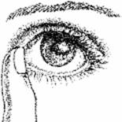
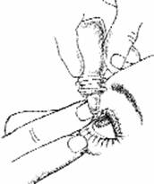
Applying Eye Drop Medicine
STEP ONE:
Tilt your head back. Using your middle finger,
gently press the corner of the eye
by the side of the nose.
STEP TWO:
Use your index finger to
pull down the lower lid.
Then apply the eye drop medicine.
STEP THREE:
After applying the eye drop, let go of your lower lid. Close the eye and keep the middle finger in place for at least two minutes. If you’re applying more than one type of drop, wait at least 15 minutes for the next application. Use a facial tissue to wipe away excess drops on eyelids.
11/1/2011

Slide 49
DISORDERS OF THE GLOBE OF THE EYE
KERATITIS
CORNEAL ABRASION OR ULCER
SCLERITIS
CATARACT
GLAUCOMA
MACULAR DEGENERATION
DIABETIC RETINOPATHY
RETINAL DETACHMENT
UVEITIS
11/1/2011

Slide 50
KERATITIS
MECHANISM
  * inflammation and ulceration of the cornea
ETIOLOGY
  * herpes simplex virus (cold sores)
  * other bacteria & fungi
  * trauma
  * dry air or intense light (welding)
11/1/2011

Slide 51
SYMPTOMS AND SIGNS
  * pain or numbness of the cornea
  * decreased visual acuity
  * irritation
  * tearing
  * photophobia
  * mild conjunctivitis
01/12/2020

Slide 52
DIAGNOSIS
  * examination of cornea using slit lamp
  * medical history
  * previous upper respiratory tract infection
TREATMENT
  * eye patch to protect from photophobia
01/12/2020

Slide 53
CORNEAL ABRASION OR ULCER
ETIOLOGY
  * foreign bodies
  * trauma (fingernail, contact lenses)
SYMPTOMS AND SIGNS
  * pain / redness & tearing
  * something constantly in eye
  * vision impairment
01/12/2020

Slide 54
DIAGNOSIS
  * visual examination
  * fluorescien (stain)
TREATMENT
  * remove foreign bodies
  * eye wear for protection & promote hearing
  * eye dressing to reduce movement
01/12/2020

Slide 55
SCLERITIS
MECHANISM
  * Inflammation of sclera
ETIOLOGY
  * rheumatoid arthritis
  * digestive disorders (Crohn’s)
SYMPTOMS AND SIGNS
  * Dull pain
  * Intense redness
  * loss of vision (posterior sclera inflammation)
  * if untreated can lead to perforation or loss of eye
11/1/2011

Slide 56
DIAGNOSIS
  * ophthalmic examination
  * Blood work to uncover underlying cause
TREATMENT
  * MILD: eye drops (antibiotics)
  * SEVERE: immunosupressive drugs
  * PERFORATION: surgery
01/12/2020

Slide 57
CATARACT
MECHANISM
  * Gradual deterioration of lens
ETIOLOGY
  * familial
  * old age
  * congenital
  * trauma
  * drug toxicity (high level of steroids)
  * diabetes mellitus
01/12/2020

Slide 58
SYMPTOMS AND SIGNS
  * Cloudy / white opaque area of the lens
  * reduce visual acuity
  * Blurring of vision
  * photosensitivity
DIAGNOSIS
  * Visual examination
  * pen light of slit lamp confers the presence of a cataract
TREATMENT
  * Intracapsular phacoemulsification
  (involves breakage of cataract then aspiration)
  * Extracapsular phacoemulsification:
  (artificial lens replacement)
11/1/2011

Slide 59
GLAUCOMA
Chronic Open-Angle Glaucoma
  MECHANISM
    * Increased intraocular pressure due to a malfunction in eyes aqueous humor drainage system - can lead to optic nerve damage
  ETIOLOGY
    * trauma
    * overuse of steriods
11/1/2011

Slide 60
SYMPTOMS AND SIGNS
  * Gradual loss of peripheral vision.
  * If untreated - eventually complete vision loss
DIAGNOSIS
  * ophthalmic examination
  * tonometry (pressure measure)
TREATMENT
  * Medication that helps decrease aqueous humor production or opens drainage system
  * laser to open drainage
  * surgery (bypass)
11/1/2011

Slide 61
Acute Angle-Closure Glaucoma
  MECHANISM
    * complete blockage of aqueous humor drainage system
  ETIOLOGY
    * trauma
11/1/2011

Slide 62
SYMPTOMS AND SIGNS
  * Blurred vision
  * severe eye pain
  * redness of the eye
  * nausea & vomiting
  * photophobia (sees “halo” around light)
  * hazy cornea (elevated pressure)
  * if untreated --> blindness
DIAGNOSIS
  * goniolens (special lens to view the opening)
TREATMENT
  * LASER IRIDOTOMY (creation of a hole in the iris between the anterior and posterior chamber)
  * medications to reduce pressure
11/1/2011

Slide 63
MACULAR DEGENERATION
MECHANISM
  (The area next to optic disc that defines fine details at the center of visual field = macula)
  * not enough blood supply to area (disappearance of central vision due to deterioration of pigment layer of retina)
ETIOLOGY
  * age
  * atherosclerosis
  * hemorrhage
11/1/2011

Slide 64
SYMPTOMS AND SIGNS
  * Fine detailed vision is impaired
  * Sharp vision deterioration (reading)
  * peripheral vision is not affected
  * loss of central vision
DIAGNOSIS
  * Ophthalmoscopy
  * fluorescein angiography
  * patient history
11/1/2011

Slide 65
TREATMENT
  * no known cure
  * laser photocoagulation
  * increase zinc in diet
  * strong magnifying glasses
11/1/2011

Slide 66
DIABETIC RETINOPATHY
MECHANISM
  * constriction of ocular blood vessels & leakage of blood into retina (microaneurysms, neovascularization = new blood vessels)
  * leakage of blood into vitreous humor
  * scar tissue
ETIOLOGY
  diabetics with uncontrolled glucose levels
11/1/2011

Slide 67
SYMPTOMS AND SIGNS
  * impaired sharp vision
  * blurred vision
  * could lead to permanent blindness
DIAGNOSIS
  * Ophthalmoscopy
TREATMENT
  * Laser photocoagulation
  * vitrectomy
11/1/2011

Slide 68
RETINAL DETACHMENT
MECHANISM
  * elevation & detachment of the retina from the choriod (partial or complete)
ETIOLOGY
  * Near sightedness (myopia)
  * trauma
SYMPTOMS AND SIGNS
  * visual floaters
  * light flashes
  * dark/opaque shadow extending form periphery inward from lower field to upper
  * If central retina is involved, could lead to blindness
11/1/2011

Slide 69
DIAGNOSIS
  * Ophthalmoscopy
TREATMENT
  * Photocoagulation (laser)
  * cryotherapy
11/1/2011

Slide 70
UVEITIS
MECHANISM
  * Inflammation of uveal tract
  (iris, ciliary body, choriod)
ETIOLOGY
  * autoimmune
  * infections (syphilis, tuberculosis, toxoplasmosis, histoplasmosis)
  * unknown etiology
SYMPTOMS AND SIGNS
  * unilateral / bilateral
  * pain
  * photophobia
  * blurred vision
  * redness
  * pupillary constriction
11/1/2011

Slide 71
DIAGNOSIS
  * complete visual examination
  * skin test for TB, toxoplasmosis, histoplasmosis
  * blood test
TREATMENT
  * treat underlying disease if known
  * cycloplegics and steroids

Slide 72
EXOPHTHALMOS
MECHANISM
  * Edema of the soft tissue that lines bony orbit of eye
ETIOLOGY
  * hyperthyroidism (bilateral)
  * hemorrhage or inflammation (unilateral)
SYMPTOMS AND SIGNS
  * protrusion of eye balls
  * dizziness
  * double vision
  * restricted eye movement
  * seriously blurred vision
11/1/2011

Slide 73
DIAGNOSIS
  * ophthalmic examination
  * blood work
  * x ray / CT
  * echography
TREATMENT
  * treat underlying disorder (thyroid)
  * surgery
  * steroids (control edema)
11/1/2011

